Slide 1

Hierarchical Task Network Planning in Common Lisp
Conquer(England)
Travel(Normandy, England)
Encamp(?x)
Pre: In(?x, England)
Take Control(England)
Pre: Ruler(?r, England)
Secure(Boats, Normandy)
Sail(Normandy, Pevensey)
Pre: In(Pevensey, England)
Slay(Harold)
Pre: Ruler(Harold, England)
Robert P. Goldman
Ugur Kuter
{rpgoldman, ukuter}@sift.net
SIFT, LLC
Portions of this work were supported by DARPA and the Air Force Research Laboratory under contract FA8750-17-C-0184. Any opinions, findings and conclusions or recommendations expressed in this material are those of the author(s) and do not necessarily reflect the views of DARPA, the Department of Defense, or the United States Government.
European Lisp Symposium 2019

Slide 2


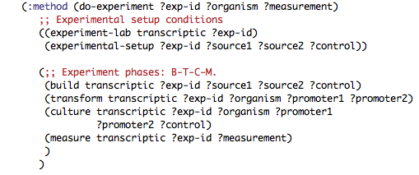

Sift and Planning
SIFT is a small, independent research lab, specializing in Artificial Intelligence, Human-Computer Interaction, Computer Security, and Formal Methods.
  We do contract- and grant-funded research, mostly for the US federal government (DARPA, NASA, Dept. of Energy, AFRL, ONR, etc.).
We have a long-standing interest in using AI in general, and planning in particular, to make systems that interact more naturally with users.
Have pursued the notion of “supervisory control,” where the user can tell a system what they want, and the system will figure out the “how.”
All of these led us to look for a very capable planner, and we settled on Shop2, developed at University of Maryland which was high performance, and powerful.
European Lisp Symposium 2019

Slide 3
Maintaining and Enhancing a Planning System in Common Lisp
Lessons from 15+ years of work with the Shop family of AI Planners, culminating in the recent release of Shop3.
Shop3 is a large CL system (~75 files, 20,000 loc, plus 185 files of test data).
Lessons learned:
  Advantages of CL:
    S-expressions provide excellent support for symbolic computation.
    Clos and generic functions ease the addition of new features to existing software artifacts.
      Good for maintenance and
      Good for exploratory planning.
    Testing with FiveAM is easy and worthwhile.
  Disadvantages:
    Temptation to use s-expressions instead of data structures should be resisted.
    Relatively poor compile-time checking.
    Half-baked DSLs.
    Meta-programming needs meta-debugging tools.
  All of the conventional software engineering rules still apply.

Slide 4
What does Shop3 involve?
Backtracking search:
  Implementation and extension of complex search benefits from the Common Lisp Object System.
Symbolic computations:
  Database retrieval;
  Rule application;
  Unification, and;
  State model update.
  All of these are convenient to do with Lisp S-expressions.
Let’s start with an introduction to AI Planning…

Slide 5
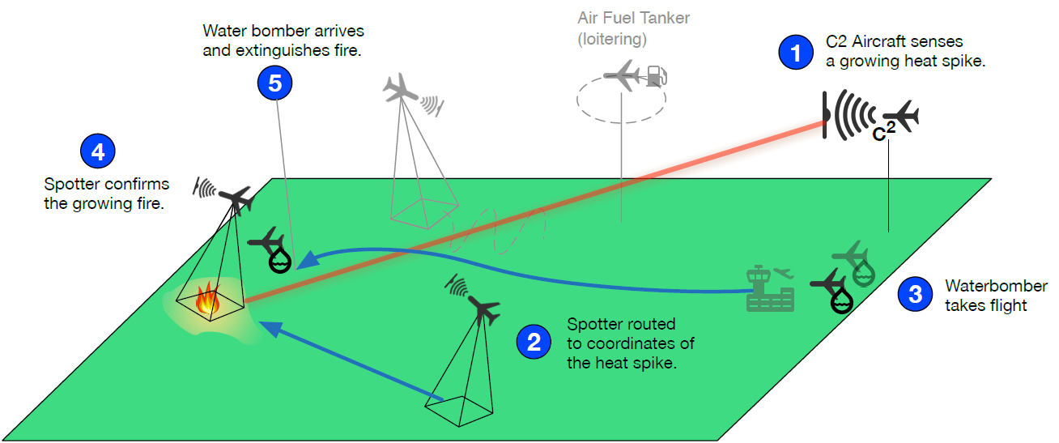
What is AI Planning?
There are one or more agents in an initial state.
  Here there are a set of firefighting UAVs, and a fire has been detected.
There is an objective: a goal to achieve or a task to perform.
  Put out the fire.
There are a set of actions (or operators) the agents can perform.
  Fly from one to another waypoint, scan to localize a fire, drop retardant on fire, etc.
The planner must generate a plan, a sequence of actions, that meet the objective.
  Fly the spotter to the fire, scan for its location, send the coordinates to the waterbomber, fly the waterbomber to the target, extinguish the fire, …

Slide 6
“Classical” Planning
The initial state is fully known.
The actions (sometimes called “operators”) are deterministic.
The actions are specified in terms of preconditions and effects.
  If the preconditions don’t hold, the action can’t be performed.
  If the preconditions hold, then after the action is done the effects will hold.
The world is modeled as a finite set of propositions each of which is either true or false.
  Effects change zero or more propositions from true to false or vice versa.
  This is a database view of the world.
Therefore, the classical planning model is a deterministic finite state transition system.

Slide 7
Why is this a hard problem?
s₁
s₀
We have a deterministic finite state system – a graph.
We need to find a path in the graph from a start node to one of a set of goal nodes.
This is a single source shortest path (SSP) problem, Dijkstra’s Algorithm, O(n²), no big deal, right?
put
take
location 1
location 2
location 1
location 2
move2
move1
move2
move1
s₃
s₂
put
take
location 1
location 2
location 1
location 2
unload
load
s₄
s₅
move2
move1
location 1
location 2
location 1
location 2
Dana Nau: Lecture slides for Automated Planning
Licensed under the Creative Commons Attribution-NonCommercial-ShareAlike License: http://creativecommons.org/licenses/by-nc-sa/2.0/

Slide 8
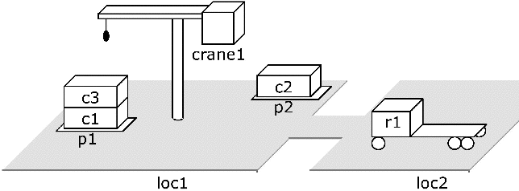
Wrong!
The actions are specified as schemas (macros).
From the initial state, with a small set of schemas, we can generate an exponentially large state space.
SSP is O(n²) where n is the size of the state space.
The state space is exponentially large relative to the size of the input.
Planning is NP-complete.
Even substantial simplifications of the classical planning problem are also NP-complete.
There are many ways to do AI Planning, but all practical methods involve heuristic search.
ACTION
      (take crane1 loc1 c3 c1 p1)
ACTION SCHEMA
(:action take
:params ?k – crane ?l – loc
?c – crate ?d – crate
?p – pile)
:precond
(and (loc ?k ?l) (empty ?k)
(attached ?p ?l)
(top ?c ?p) (on ?c ?d))
:effect
(and (holding ?k ?c)
(not (empty ?k))
(not (in ?c ?p))
(not (top ?c ?p))
(not (on ?c ?d))
(top ?d ?p)))
Dana Nau: Lecture slides for Automated Planning
Licensed under the Creative Commons Attribution-NonCommercial-ShareAlike License: http://creativecommons.org/licenses/by-nc-sa/2.0/

Slide 9
Limitations of Classical Planning
Our planner for biology experiments:
Transform RPU standard plasmid pAN1717 (4) and autofluorescence control plasmid pAN1201 (3) into NEB 10-beta
Cotransform E. coli NEB 10-beta (3) with plasmid pAN2928 (1) and pAN4038 (2)
Pick a single colony from each of three transformations and inoculate into M9 media w/ appropriate antibiotics for overnight growth in V-bottom 96-well plate
Next day; dilute cultures; grow for 3 hours in M9 w/ appropriate antibiotics
Dilute and split cultures; Induce with 8 different inducer concentrations
Grow for 5 hours then add culture to PBS + Kan to arrest growth
Measure > 1000 cells for each strain / inducer condition with Flow Cytometry
Even though classical planning is very hard, what it can do is so limited that it is rarely helpful in applications.
  Can’t handle continuous quantities:
    e.g., fluid quantities.
  Must be extended to handle time and concurrency;
  Can’t create or destroy entities:
    e.g., create some number of cell populations;
  Objectives that are tasks instead of goals:
    e.g., perform an experiment to verify the accuracy of a cell design;
  Can’t enforce standard operating procedures:
    e.g. grow for 5 hours before stopping growth “just because.”

Slide 10
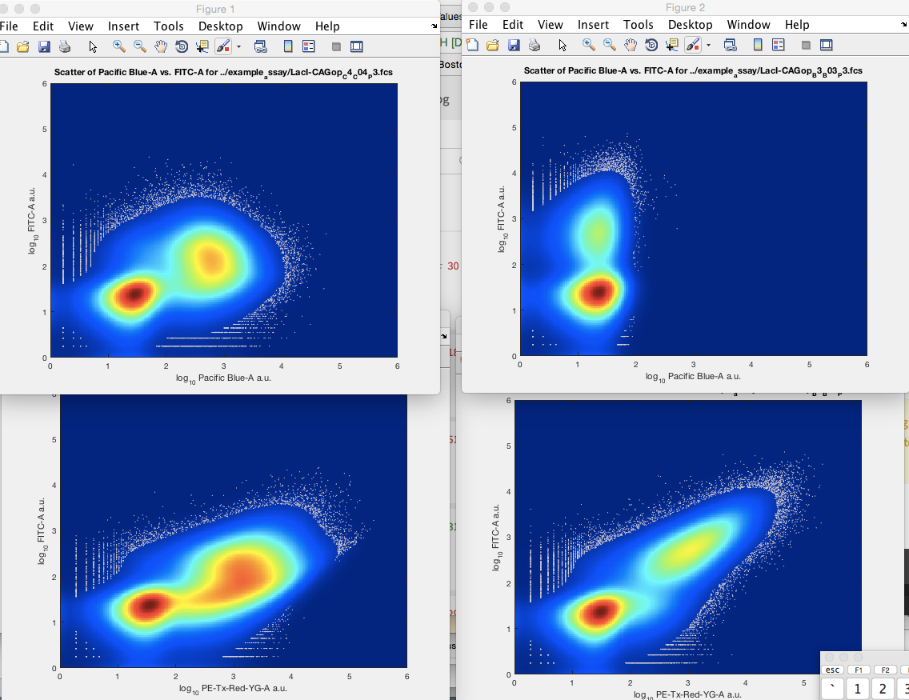
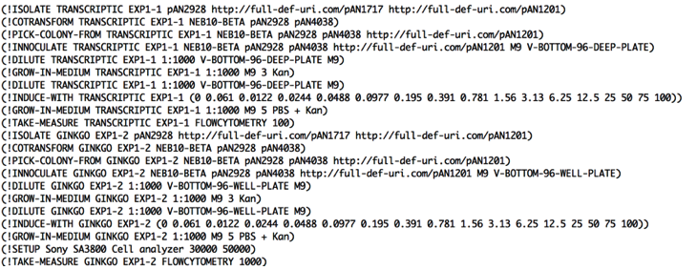

Limitations of Classical Planning
Sample Plan

Slide 11
Limitations of Classical Planning
Even though classical planning is very hard, what it can do is so limited that it is rarely helpful in applications.
  Can’t handle continuous quantities:
    e.g., fuel for the UAVs;
  Must be extended to handle time and concurrency;
  Can’t create or destroy entities:
    e.g., plan to make some number of new cars;
  Objectives that are tasks instead of goals:
    e.g., the task of running around the track for exercise;
  Can’t enforce standard operating procedures:
    e.g., if the patient presents with a heart attack, give them aspirin “just because.”
Even though classical planning is very hard, what it can do is so limited that it is rarely helpful in applications.
  Can’t handle continuous quantities:
    e.g., fluid quantities.
  Must be extended to handle time and concurrency;
  Can’t create or destroy entities:
    e.g., create some number of cell populations;
  Objectives that are tasks instead of goals:
    e.g., perform an experiment to verify the accuracy of a cell design;
  Can’t enforce standard operating procedures:
    e.g. grow for 5 hours before stopping growth “just because.”
Hacks exist for working around these, but they add up …
Photo by Shane Aldendorff from Pexels

Slide 12
What is Hierarchical Task Network (Htn) Planning?
Task:
travel(x,y)
Problem reduction (decomposition).
Tasks (activities) rather than goals.
Methods to decompose tasks into subtasks.
Enforce constraints:
  Taxi not good for long distances.
Backtrack if necessary:
  No flights from BWI to TLS; backtrack and try IAD instead.
Method: taxi-travel(x,y)
Method: air-travel(x,y)
get-taxi
pay-driver
get-ticket(a(x),a(y))
ride(x,y)
fly(a(x),a(y))
travel(a(y),y)
travel(x,a(x))
travel(UMD, LAAS)
get-ticket(BWI, TLS)
get-ticket(IAD, TLS)
travel(UMD, IAD)
fly(BWI, Toulouse)
travel(TLS, LAAS)
go-to-travel-web-site
find-flights(BWI,TLS)
go-to-travel-web-site
find-flights(IAD,TLS)
buy-ticket(IAD,TLS)
BACKTRACK
get-taxi
ride(UMD, IAD)
pay-driver
get-taxi
ride(TLS,Toulouse)
pay-driver
Dana Nau: Lecture slides for Automated Planning
Licensed under the Creative Commons Attribution-NonCommercial-ShareAlike License: http://creativecommons.org/licenses/by-nc-sa/2.0/

Slide 13
How is HTN Planning done?
travel(UMD, LAAS)
get-ticket(BWI, TLS)
get-ticket(IAD, TLS)
travel(UMD, IAD)
fly(BWI, Toulouse)
travel(TLS, LAAS)
go-to-travel-web-site
find-flights(BWI,TLS)
go-to-travel-web-site
find-flights(IAD,TLS)
buy-ticket(IAD,TLS)
BACKTRACK
get-taxi
ride(UMD, IAD)
pay-driver
Queue of tasks
Choose a task to expand
If the task is primitive
  Insert corresponding action in the plan: check the preconditions and apply the effects
Else (task is not primitive):
  Choose a method to use
  Apply the method: check the preconditions, replace the task in the queue with the task network from the method
Repeat, backtracking as necessary, until the task queue is empty, then return the plan.
get-taxi
ride(TLS,Toulouse)
pay-driver

Slide 14
Other Features of the Shop Family of Planners
Shop is a forward planner, meaning it always builds plans from a known state to a successor.
  This unlocks substantial expressive power: there are actions like machining that are easy to model forward, but are not regressible.
  We can predict what happens when one flies from point A to point B, and we can undo that, but it’s hard to say “what position do you need to be in to reach point B after flying.”
Shop permits the invocation of arbitrary CL code in planning.
  E.g., can invoke a special purpose geometric path planner to plan flight routes.
Shop provides a Prolog-like prover for use in reasoning about the state.
  Rules permit cleaner, more understandable formulation of planning operators and methods.
Caveat Emptor:
  Rash use of these features can compromise the completeness, and even soundness of the planner.
  AI Planning researchers generally dislike Htn planners, because they don’t “work things out for themselves.”

Slide 15
Caveat Emptor
Rash use of these features can compromise the completeness, and even soundness of the planner.
AI Planning researchers generally dislike Htn planners, because they don’t “work things out for themselves.”
  But they can typically ensure that the classical planning assumptions hold for their problems.

Slide 16
Shop2 to Shop3: First steps
“Gradware” to library:
  Get it into revision control system (then subversion, now git).
  Add ASDF system definitions.
  Wrap in packages for safe use as a library.
  Add extensive test suite.
  Set up continuous integration to test after commits.
  Fix some premature optimizations.
Replace use of s-expressions as primary data structure:
  CL’s :list type structures were hugely helpful here.
  Process:
  add defstruct corresponding to a data type as a list
  Replace car, cdr, etc. accesses with structure accessors
  Replace the list implementation with a “true” structure.

Slide 17
Extending functionality
First substantial extension was to add temporal planning: actions with durations, and concurrent action by multiple agents [Goldman, 2006]. Others include
  Pddl planning – different semantics for quantification, etc.
  Monte Carlo Tree Search planning – randomized optimizing search.
Needed to be able to modify arbitrary behaviors in Shop.
Clos provided the obvious solution:
  Replace functions with generic functions and methods.
  Search functions such as Seek-plans-primitive, Seek-plans-NONprimitive, and Sort-tasks.
  State objects and update functions: Apply-action, Apply-operator, and Apply-method.

Slide 18
How to tailor Planner behavior with Clos?
The key input data structures are:
  Domains – sets of actions and methods – the “physics” -- and
  Problems – initial states and objectives.
Domains are the obvious choice:
  Problems “dissolve” into states and tasks.
  Domain must be consulted for method and operator definitions throughout planning.
There is also the :which argument – tailors search. For example:
  :first – return the first plan
  :all
  :id-first – first plan found by iterative deepening
Most key functions dispatch on domain and which argument.
  Clos multi-methods.

Slide 19
Making Shop more usable
Repairing the Shop input language.
Add support for Pddl – the Planner Domain Description Language.
Improve robustness and debuggability of planner.
Supply tools for interacting with Shop’s outputs.
Make components available for reuse.

Slide 20
Shop Input Language
(:operator (!set-money ?person ?old ?new) ((has-money ?person ?old)) ((has-money ?person ?old)) ((has-money ?person ?new))) (:method (travel-to ?y) by-taxi ((at ?x) (at-taxi-stand ?t ?x) (distance ?x ?y ?d) (have-taxi-fare ?d)) ((!hail ?t ?x) (!ride ?t ?x ?y) (pay-driver (call + 1.50 ?d))) by-bus ((at ?x) (bus-route ?bus ?x ?y)) ((!wait-for ?bus ?x) (pay-driver 1.00) (!ride ?bus ?x ?y)))
Ad hoc DSL that “just grew.”
Problems:
  Syntactic ambiguity (e.g., implicit conjunctions, variable number of arguments).
  Poor visual marking:
    Operator definitions had 4, 5, or 6 positional arguments).
    Problem definitions had multiple visually indistinguishable alternative forms.
    Logical variables all globally scoped.
  Extra grouping constructs for no good reason.
  Haphazard use of keyword vs. normal symbols.

Slide 21
Fixing the Shop Input Language
Introduce keyword-based alternatives for positional arguments.
Limit or Eliminate DWIMing of arguments.
  Positional arguments + ”internal” optionals. 🤮
Replace internal s-expression storage with data structures.
  Easier to diagnose the results of parsing problems.
Lift ideas from Prolog:
  Introduce anonymous variables for singletons.
  Check for undefined predicates, etc.
(:op (!set-money ?person ?old ?new)
:precond (and (has-account ?person)
(has-money ?person ?old))
:delete (has-money ?person ?old))
:add (has-money ?person ?new))
(and (hotel ?loc ?rooms ?_ha)
(> ?rooms 1)) ; don’t care
(and (hotel ?loc ?rooms ?handicap)
(== ?handicapp yes)) ; typo

Slide 22
Pddl support
Pddl is the Planner Domain Description Language.
Standard language for domains and problems.
Better engineered than the Shop language.
But covers only actions, not methods.
There are a large number of example problems from the International Planning Competition.
(:action set-money
:params (?p - person
?old ?new - funds)
:precond (and (has-account ?person)
(has-money ?person ?old))
:effect
(and
(not (has-money ?person ?old))
(has-money ?person ?new))
Pddl has multiple dialects, selected by :requirements keyword.
  E.g., typed, temporal, conditional effects, etc.

Slide 23
PDDL support 2
Defdomain
Shop3 offers full Pddl support.
Generalize domain processing with Clos.
:around methods to reuse existing code.
:type keyword
Domain component forms
Domain object
Parse-domain-items
Syntax keyword (eql) and domain dispatch
Process-op, Process-method,
Process-action, etc.
Parse-domain-item

Slide 24
Shop3 Tool Support
Shop3 can produce more than simply a sequence of actions.
  Shop3 can produce a plan tree, relating tasks to their decompositions (how they are performed). Used for context-based execution.
  Shop3 can produce a state sequence, describing the trajectory of states entailed by the action sequence. Used for intelligent rendering.
Building on other CL libraries, we have developed and incorporated tools for:
  Configurably graphing plan trees.
  Querying plan trees (useful for, e.g., executing plans).

Slide 25
Reusing Shop3 Components
Shop’s unifier is a highly optimized unification engine. It can be loaded separately and used on its own as a part of other systems.
Similarly, the Shop theorem-prover, incorporating the unifier, can be loaded and used on its own for Prolog-style problem solving.

Slide 26
Shop3 Architecture
Shop3
Shop I/O: parsing/loading domains and problems; pretty-printing data structures
Planner operations: task decomposition/reduction functions, state progression
(Legacy) search engine
Explicit Stack Search (ESS) search engine
Shop Plan tree objects, update functions
Shop Plan Grapher
Shop Theorem prover
API – query functions
Shop Theorem prover
Domain objects, Inference rules, language extensions
and processing
Shop Common: state objects, state update functions, state trajectories.
Shop Unifier: variables, variable bindings, unification, matching, substitution.

Slide 27
Explicit Stack Search (ESS)
The original search routine for Shop2 is a set of mutually-recursive functions that are not tail-recursive (to support backtracking).
  Caused problems with stack overflows.
  Extremely difficult to experiment with alternative search strategies.
    All the original search strategies are variants of depth-first search.
    We wanted to experiment with backjumping to do targeted plan repair.
Coming to the opinion that doing search with the process stack is an anti-pattern.
We now provide an alternative form of search in which the program maintains its own stack of choice points, and manages its own backtracking.

Slide 28

Implementing ESS
Techniques modeled on those used in CIRCA [Musliner, et al., 1993].
Build a virtual stack machine for search.
Stack has markers and change records.
Change records have undo methods for backtracking.
Clos heavily used in stack management.
stack

Slide 29
ESS Payoff
Able to implement plan repair through backjumping using ESS.
Fewer stack overflows.
Somewhat to our surprise, consistently more efficient than using the process stack.
More elegant code by packaging the state variables of the search into an object.
Virtual Machine approach a generally good one for search programs.

Slide 30
Contributions of Common Lisp
Hazards of Common Lisp
S-expressions are The Right Thing for unification and symbolic computation.
Clos provides powerful tools for both software maintenance and software extension.
Procedural attachment is convenient and powerful.
Temptation to use s-expressions instead of data structures. Breaks runtime error-checking.
Relatively poor compile-time checking.
Half-baked DSLs.
Meta-programming needs meta-debugging tools.
Notes:
Mention Ryan Culpeper’s tool – can we have tactics for transforming functions into generic functions.
Even SBCL, which is very tight, doesn’t make it easy for us to make arbitrary claims about our software. Existing type systems seem to be aimed at either efficiency or correctness, but not both.

Slide 31

Shop3 is now freely available.
https://github.com/shop-planner/
Mozilla Public License.

Slide 32
Shop3 is now freely available.
https://github.com/shop-planner/
Mozilla Public License.

Slide 33
Limitations of Classical Planning
Even though classical planning is very hard, what it can do is so limited that it is rarely helpful in applications.
  Can’t handle continuous quantities: e.g., fuel for the UAVs;
  Must be extended to handle time and concurrency;
  Can’t create new entities: e.g., plan to make some number of new cars;
  Nuisance to handle tasks instead of goals: e.g., the task of running around the track for exercise;
  Can’t handle standard operating procedures: e.g., if the patient presents with a heart attack, give them aspirin “just because.”
Hacks exist for working around these, but they add up →

Slide 34
Summary
Shop3 is an AI Planning System built in Common Lisp.
Specifically, it is a Hierarchical Task Network (HTN) Planner.
What are these things? And why did we want them?
Building on Shop2.
Lessons learned.

Slide 35
What is AI Planning?
There are one or more agents in an initial state.
  Here there are a set of firefighting UAVs, and a fire has been detected.
There is an objective: a goal to achieve or a task to perform.
  Put out the fire.
There are a set of actions (or operators) the agents can perform.
  Fly from one to another waypoint, scan to localize a fire, drop retardant on fire, etc.
The planner must generate a plan, a sequence of actions, that meet the objective.
  Fly the spotter to the fire, scan for its location, send the coordinates to the waterbomber, fly the waterbomber to the target, ...

